Slide 1


Home Nest
Simplifying service, Amplifying Trust
Presentated by:
Harithik Choudhary
UnniKrishnan G

Slide 2



Problem Statement
Problem 1: Availability and Urgency
Finding service providers on short notice is difficult.
Urgent needs, such as home repairs, require immediate assistance.
Traditional methods (online search, recommendations) are often too slow.
Problem 2: Quality and Expertise
Finding skilled service providers in a short time is challenging.
Pressure to act quickly may lead to choosing less qualified providers.
Limited time reduces the ability to thoroughly vet service providers.
Problem 3: Safety and Trust
Concerns about the reliability and trustworthiness of providers.
Traditional methods may not guarantee the provider’s safety or trust.
Individuals need assurance that service providers are vetted and safe.

Slide 3


The Solution
Our platform, Home Nest is a comprehensive platform which is specifically created to tackle the challenges faced by individuals when searching for reliable service providers on short notice.
Quick Connection: Instantly matches users with available service providers.
User-Friendly: Simple, easy-to-navigate interface for all users.
Real-Time Matching: Prioritizes urgent requests for immediate help.
Verified Profiles: Only qualified, verified professionals are listed.
Skill-Based Filtering: Find providers based on specific expertise.
Background Checks: Ensures safety with comprehensive provider vetting.

Slide 4




Key Features
Real-time Matching
Verified Profiles
Skill-based Filtering
Background Checks
Immediate Availability
Geolocation-Based
Urgent Requests Prioritization
Credential Verification
Verified Badges
Consistent Monitoring
Customized Search
Expertise Categories
Quick Selection.
Comprehensive Screening
Safety Assurance
Trustworthy Providers

Slide 5
01
Service Creation and Management:
Service providers can create and manage detailed listings for the services they offer, including descriptions, pricing, and availability.
02
Service Booking and Navigation:
Users can search, filter, select, and book service providers based on their needs. The platform also provides navigation assistance to help service providers reach the client’s location efficiently
In-Scope
03
User and Provider Registration:
Both users and service providers can easily register on the platform, creating profiles with all necessary details, ensuring a seamless experience for both parties.
04
Payments, Reviews, and Suggestions:
Users can securely make payments for services, rate and review service providers based on their experience, and receive personalized service recommendations based on their profile and past interactions.

Slide 6
Advanced Features and AI-Driven Matching:
The platform will use basic matching algorithms but will not include advanced AI-driven personalization, recommendation features, or in-depth analytics and reporting.
01
01
02
Inventory and Offline Payment Management:
Service providers will not have tools for managing inventory or supplies, and the platform will only support digital payments, excluding offline payment methods like cash on delivery.
02
03
Future-Scope
Service Provider Training and Real-Time Communication:
Training and certification programs for service providers are not included, nor will there be real-time chat functionality between users and providers but that can be included in later stage.
03
04
Expanded Listings and Multilingual Support:
The platform will focus solely on service-based listings, without support for non-service-related products, and will not include multilingual support in this initial version.

Slide 7

Challenges
Addressing Safety Concerns
Limitations:
No method can completely guarantee safety for users and providers
Concerns:
Female service providers and users may feel unsafe in certain situations.
Possible Mitigations
Implementing gender preferences, ID verification, panic buttons, and accompaniment options.

Slide 8
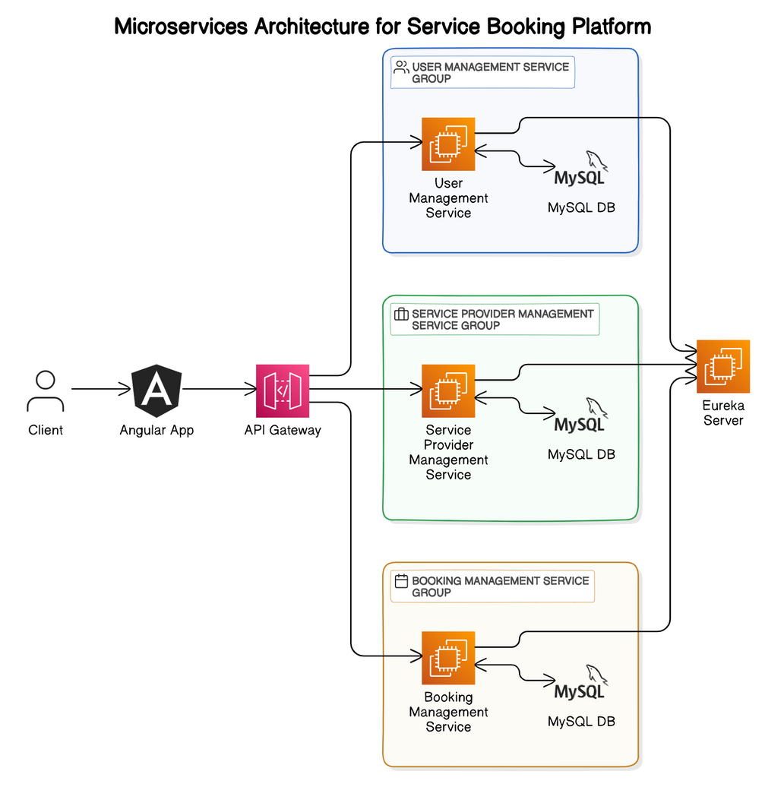
Architecture Diagram

Slide 9
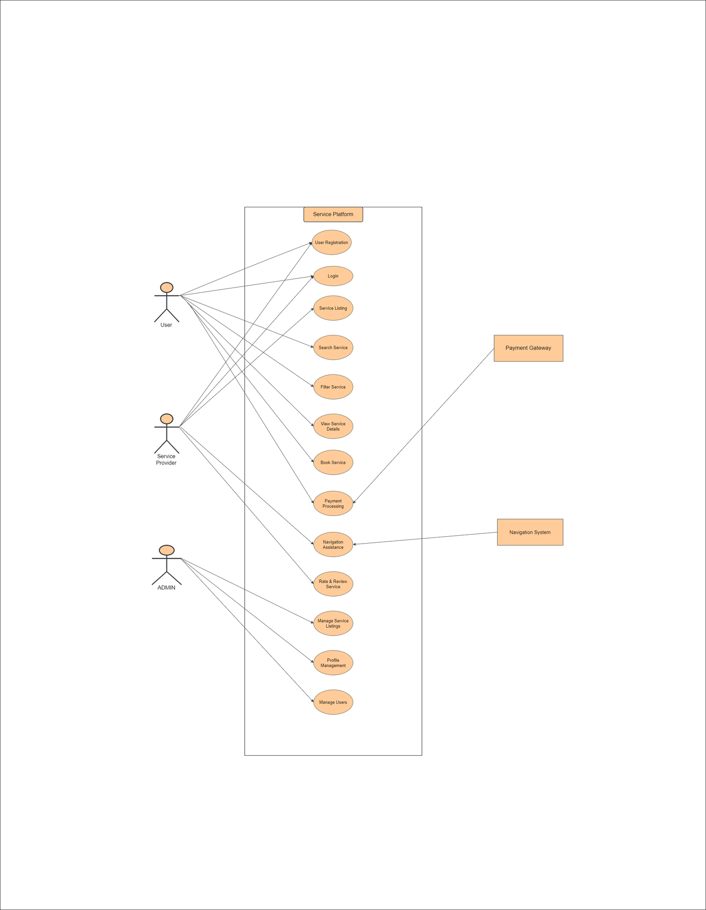
Use Case Diagram
User Personas
User
Service Provider
Admin

Slide 10
Conclusion
The project, Home Nest, aims to create a reliable and user-friendly platform that connects individuals with skilled service providers for tasks like home repairs, cleaning, tutoring, and personal care. Recognizing the challenges users face in finding qualified professionals on short notice, Home Nest focuses on providing quick, efficient, and safe solutions. The platform is designed to ensure users can easily find and book trusted service providers while enabling service providers to manage their listings and connect with potential clients effectively.
Next Steps:
Development and testing phases.
Continuous improvement based on user feedback.

Slide 11


Our Team
Harithik Choudhary
Unnikrishnan G
Developer-1
Developer-1

Slide 12
Thank you

